Slide 2
Software Defined Infrastructure
An overview of where we are going

Slide 3
Goals
High level tour of some capabilities
Demonstrate the simplicity of the concept

Slide 4
Specific Features
Simple network segmentation
Items within a network cannot talk to others when not in same network
Show bridge, container spanning both networks
Load balancing
Across servers
Service Discovery
Inbuilt no static IP
No access from outside of docker swarm unless expose a port

Slide 5
SDI – Seg1
group1_net
Single network
Called group1_net
3 services
Single container per service
Simulates a three tier application
Demonstrate
Single instance of each container
Network spans all nodes in swarm
Containers running across multiple nodes in Swarm
Service discovery between containers on same network
frontend1
middle1
backend1

Slide 6
SDI – Seg2
group1_net
group2_net
frontend1
middle1
backend1
frontend2
middle2
backend2
Two networks
Called group1_net, group2_net
Each running 3 services with a single container in each service
Demonstrate
Services running in one network cannot see services in the other

Slide 7
SDI – Seg3
bridge
group1_net
group2_net
frontend1
middle1
backend1
frontend2
middle2
backend2
Demonstrate
Add a service with a single container that is a member of both networks
Bridge service can see all other services

Slide 8
SDI – Seg4
frontend_net
frontend1
3 networks
Represents a layered network
Only certain parts of an application are able to communicate with other parts
middle_net
middle2
backend_net
backend1

Slide 9
SDI – Seg5
group1_net
group1_net
frontend1
middle1
backend1
frontend1
middle1
backend1
Environment DEV
Environment QA
Demonstrate
Creating environments using single template
1 Environment called DEV
1 Environment called QA
Each environment is separate and cannot interact at a network level

Slide 10
SDI – LB1
Single network
Called group1_net
3 services
3 containers per service
Demonstrate
Load balancer in front of each service
group1_net
LB
LB
LB
frontend1
middle1
backend1
frontend1
middle1
backend1
frontend1
middle1
backend1

Slide 11
SDI – Ingres1
LAN
Single network
Called group1_net
3 services
2 containers in frontend service
Single container in other services
Demonstrate
Map outside port to inside port
Load balancer from outside
Ingres from any swarm node
Port 8080
LB
Swarm
group1_net
Port 80
frontend1
middle1
backend1
frontend1

Slide 12
SDI – Scale1
group1_net
frontend1
middle1
backend1
frontend1
$ docker service scale jon_frontend1=3
Single network
Called group1_net
3 services
2 containers in frontend service
Single container in other services
Demonstrate
Scale frontend service up to 10 containers
Scale frontend service down to 3 containers

Slide 13
SDI – Rolling1
group1_net
Single network
Called group1_net
3 services
3 containers for frontend service
Single container for other services
Demonstrate
Upgrade the frontend service using a rolling upgrade
Selects a single container and stops old version and starts a new version
Waits to ensure stability then moves onto to next container
Can control number of services, delay, etc
frontend1
middle1
backend1
frontend1
frontend1
docker service update --image joncatlin/nginx-demo:2.0 jon_frontend1

Slide 14
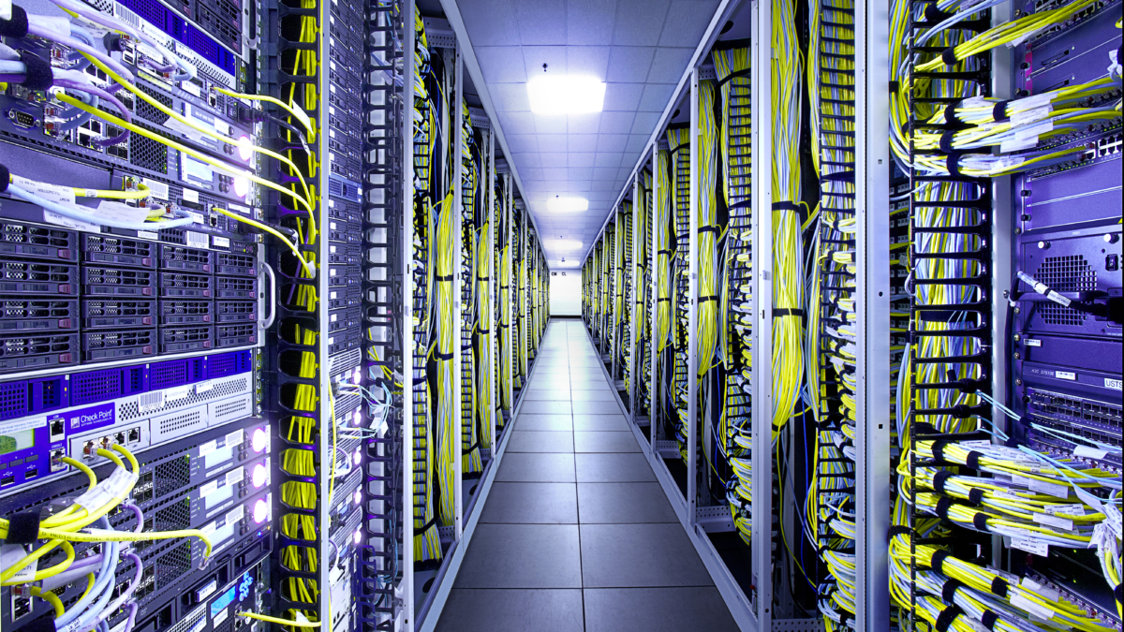
Systems & Equipment

Slide 15
Systems & Equipment – Where are we today?
? Get the information from the slides that were presented as a refresher

Slide 16

QUESTIONS

Slide 17
Questions
?

Slide 19
Goals
Outline where we are going
Answer questions
Provide a vision that people can buy into
Obtain buy in from the staff
Explain how to get there

Slide 20
ADAPT
What is it
Why are we doing it
Where does it fit in the overall Strategy

Slide 21
Solution Design Teams
This is a mechanism we are using to move pieces of the puzzle forward
Solution design team selected Appian for a DockIT replacement

Slide 22
Book Clubs
Broaden learning
Challenge the status quo
Increase skills in important areas

